Slide 1
Skin disease Imagery prediction
A mark of distinction or commonality
Team 11
Aaron Soto | Danny Koudede | Felix Gonzalez | Lucas Okose | Deandrea Norris

Slide 2

Data preprocessing
Selection of 4 datasets with little to no similarity
CNN – image allowance and accuracy
Model Fit

Slide 3
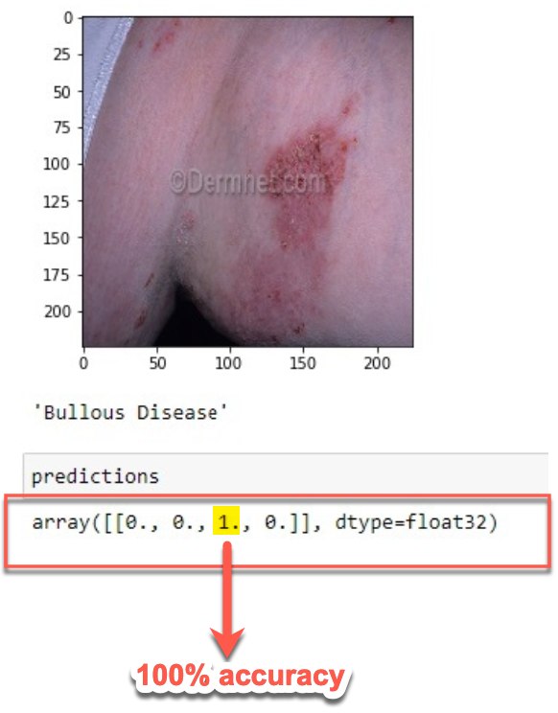
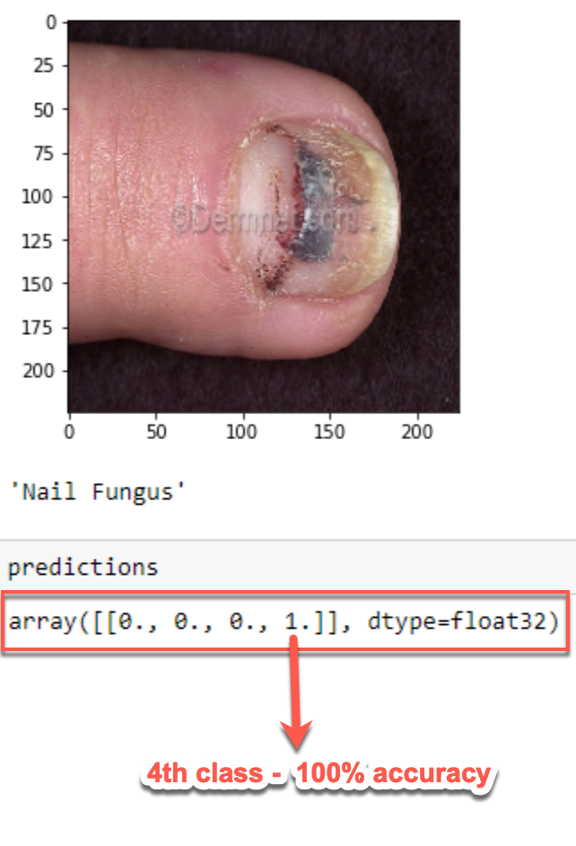
Model evaluation metrics
Notebook 1
Skin_Disease_ML
Successful
Complete Prediction
- # of Classifications – 4
Notebook 2
Skin_Disease_Trial
Unsuccessful
Incomplete attribute changes
- # of Classifications - 2

Slide 4
Model diagram

Slide 5
Issues / recommendation
Flask App
Data set –
Low epoch = low accuracy
Number of images
Sequential model error
EVERYTHING
THAT COULD…

Slide 6

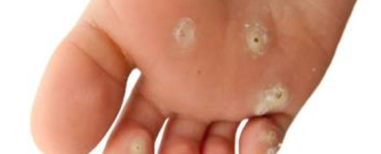
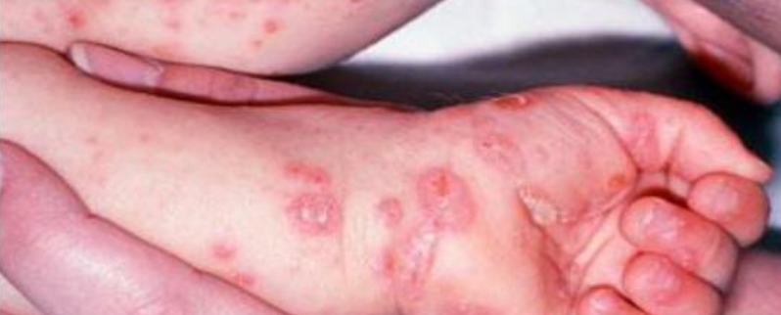
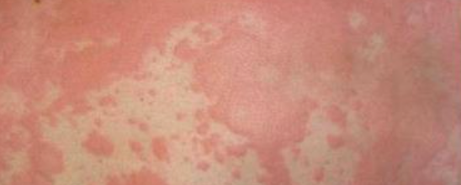
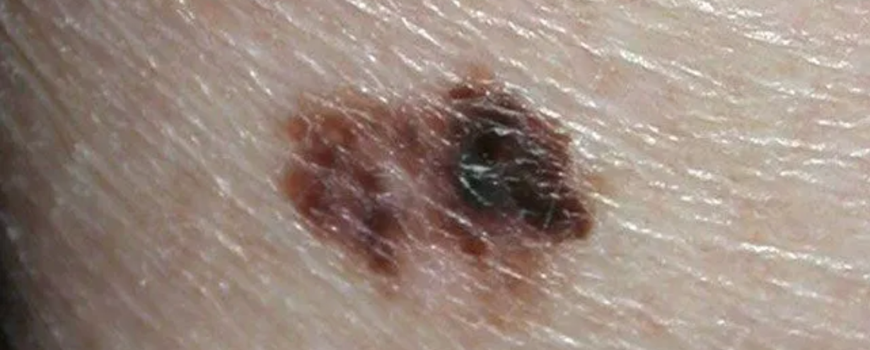
Skin facts…
Rash
Skin is our largest organ
Adult skin accounts for about 16 percent of total body weight and covers a surface area of approximately 22 square feet.
Serves as a protective shield against heat, light, injury and infection.
Fungal infection
Scabies
Melanoma

